Slide 1



Power BI 101
Mithra Ravichandran
Women in AI

Slide 2
Agenda
Learning Objective
Introduction to Power BI
Platform types & Process flow
Elements of Power BI
Fully functional Dashboard demo
Q and A

Slide 3
Learning Objective
Basic Concepts
Manipulating data
Understanding the basic features, interface and navigation of Power BI
Learning to work with data in Power BI
Connecting to Data Sources
Creating visualization & dashboards
Linking various data sources and importing data into Power BI.
Learning to create simple visualizations and sharing dashboards

Slide 4

Introduction to Power BI
What is BI?
Cloud-based BI service by Microsoft
Released in 2011
Installing Power BI:
http://app.powerbi.com
Download Microsoft Power BI Desktop from
Official Microsoft Download Center
Real time data analysis
Quick Insights
Data source Integration
Cost-Effective

Slide 5
Types of Platform and versions
Power BI Desktop
Power BI Service
Power BI Mobile
A desktop application
Can be published to Power BI Service
Example of SaaS
The published version can be shared to others
App version for iOS and Android devices
License: Free version, Power BI pro, Power BI Premium

Slide 6
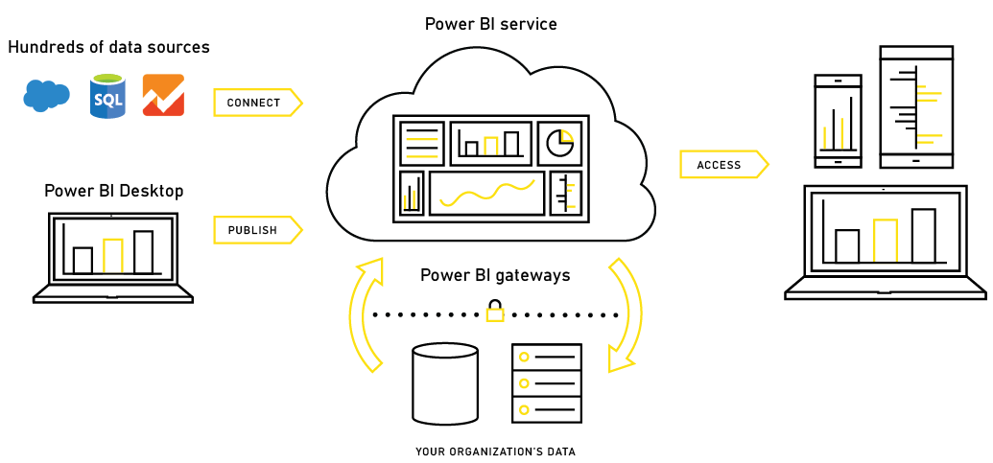



Process flow
Multiple data sources

Slide 7
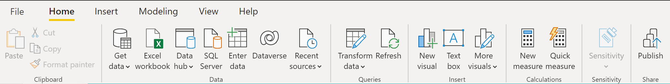

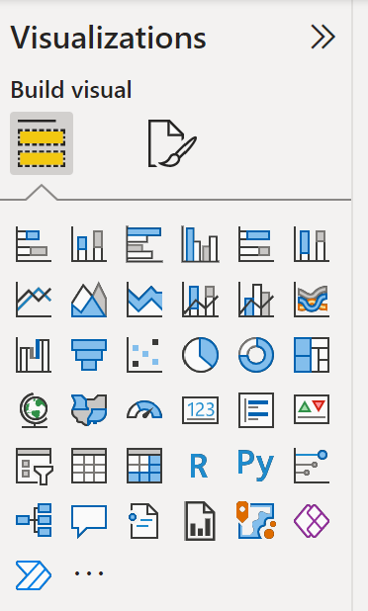
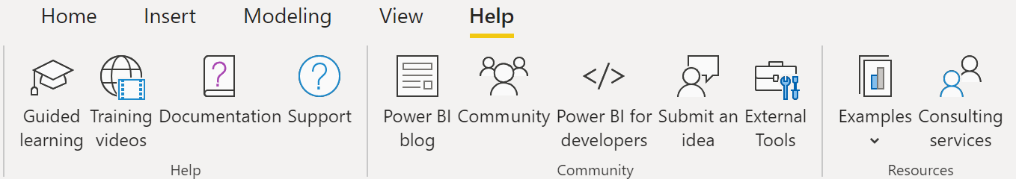
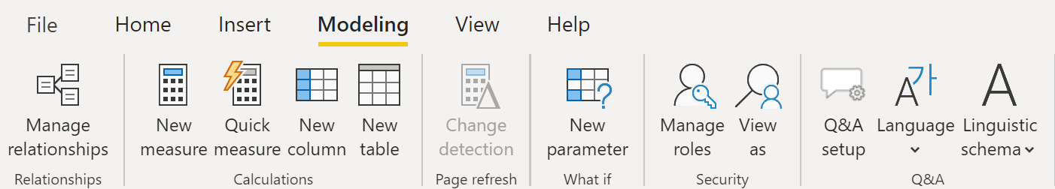
Elements of Power BI
Views of Power BI
Report
Data
Model

Slide 8
Power BI Dashboard Demo

Slide 9
Beyond this session!
Power Query
Data Analysis eXpressions
Adding Columns /changing data types / other data-driven tasks
Creating Measures and calculated columns
Advanced Analytics
Security
Managing roles – Admin, Member, Contributor, Viewer
Data models created using R can be Integration with Power BI

Slide 10
Q & A
Thank you !!

